Slide 1


Data Mining & Machine Learning
Coursework Presentation Group_PG 14

Slide 2
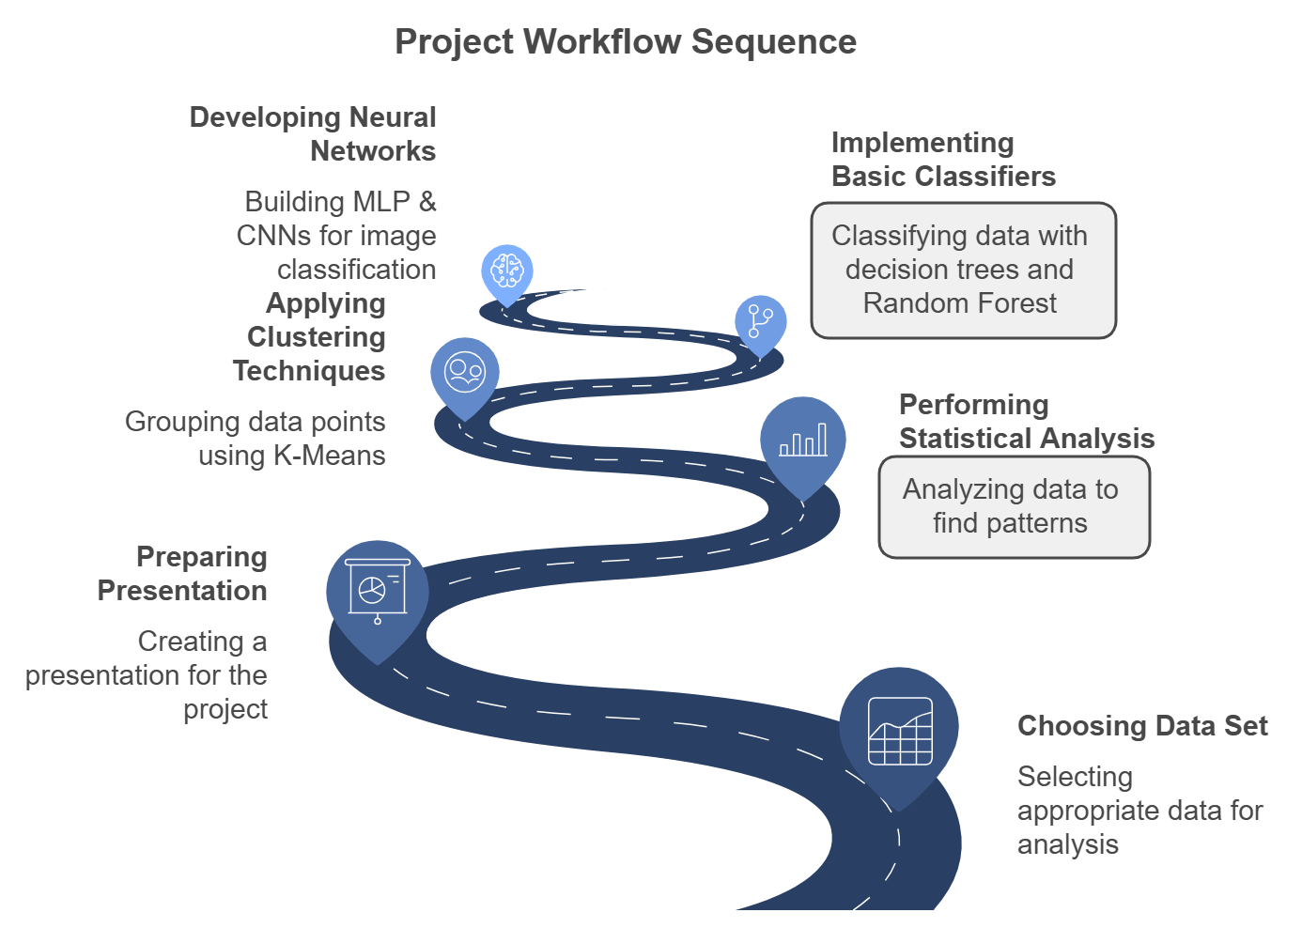

Slide 3
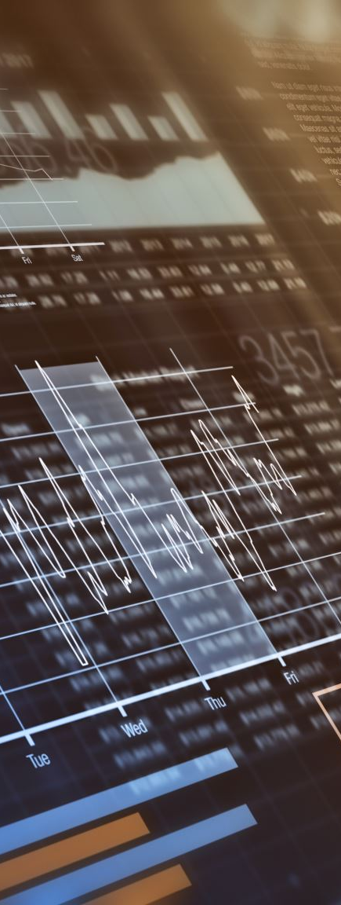
Introduction - Project Topics
Exploring advanced machine learning techniques on:
1. Financial distress prediction dataset.
2. Sign Language MNIST dataset for gesture recognition.
Alternative Data Set: Loan Dataset

Slide 4
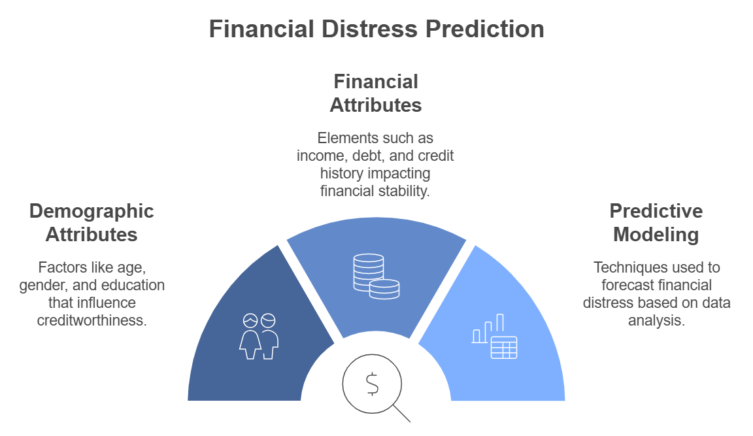
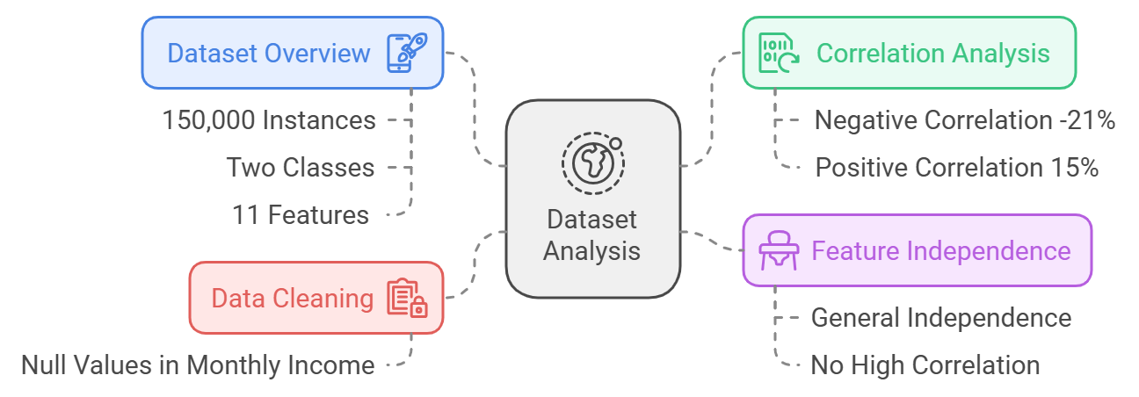
The aim of this dataset is to predict whether a person is likely to experience a serious financial delinquency in the range of two years. This enables financial institutions to evaluate the creditworthiness of each customer and make informed loaning decisions.
Binary and fairly complex dataset.

Slide 5
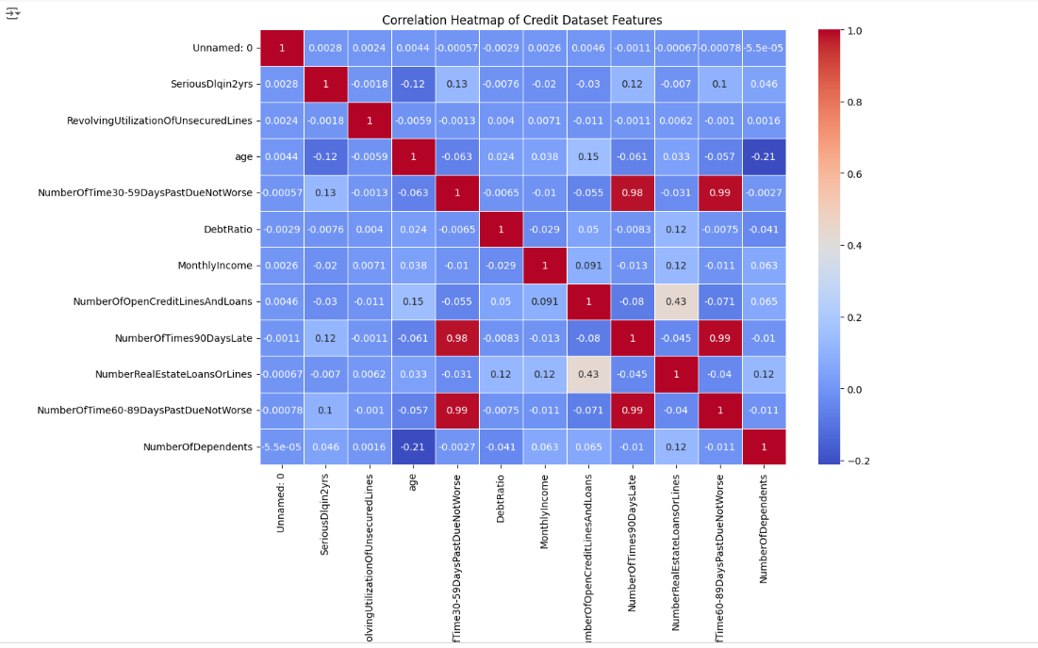
Introduction - Project Topics
1. Financial distress prediction dataset.

Slide 6
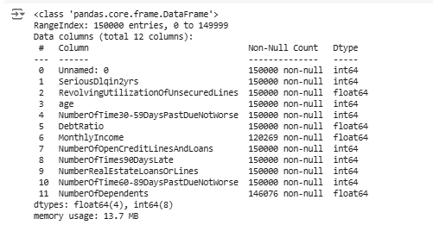
1. Financial distress prediction dataset.
Number of records after removing outliers: 108262

Slide 7
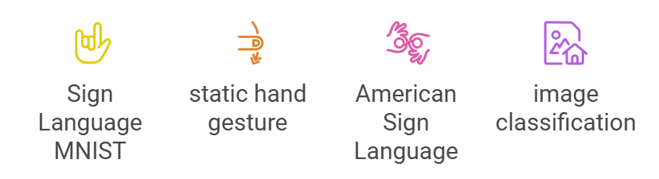
Dataset 2: Sign Language MNIST
Alternative Dataset: Loan Dataset
Similar to our main data set we applied the similar methods as we use median values for each feature to replace the missing values. Using median skewed the distribution and caused less distortion with skewness or outliers, preserving the central tendency closer to the actual "middle" of the data.

Slide 8
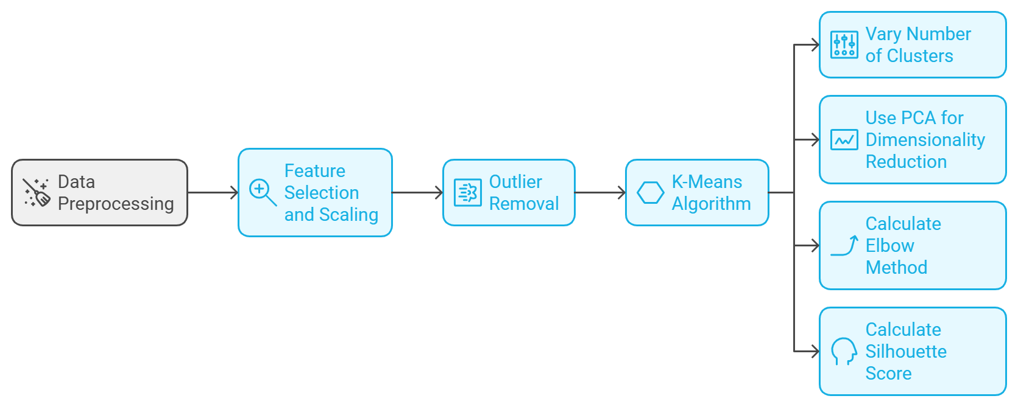
Clustering Analysis
Methods:
- K-Means with PCA for dimensionality reduction.
- Metrics: Elbow Method, Silhouette Score.
Key Findings:
- Optimal clusters: 4.
- Distinct customer segmentation for targeted insights.

Slide 9
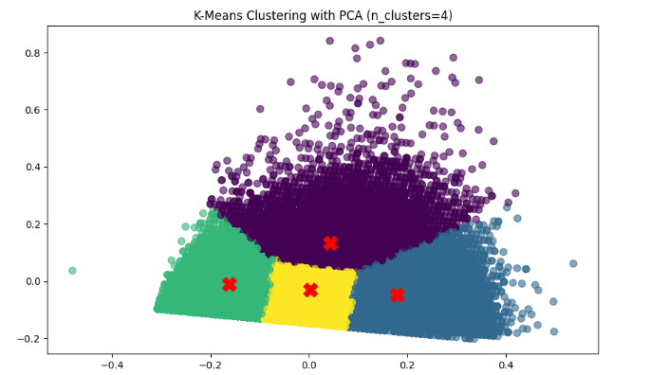
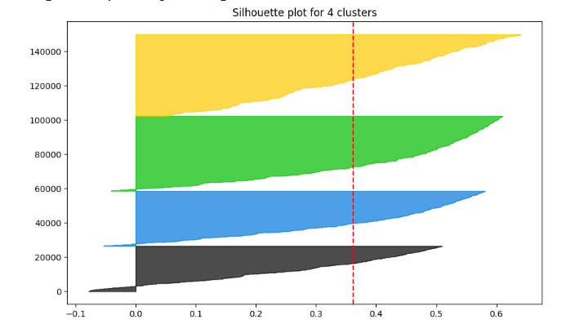
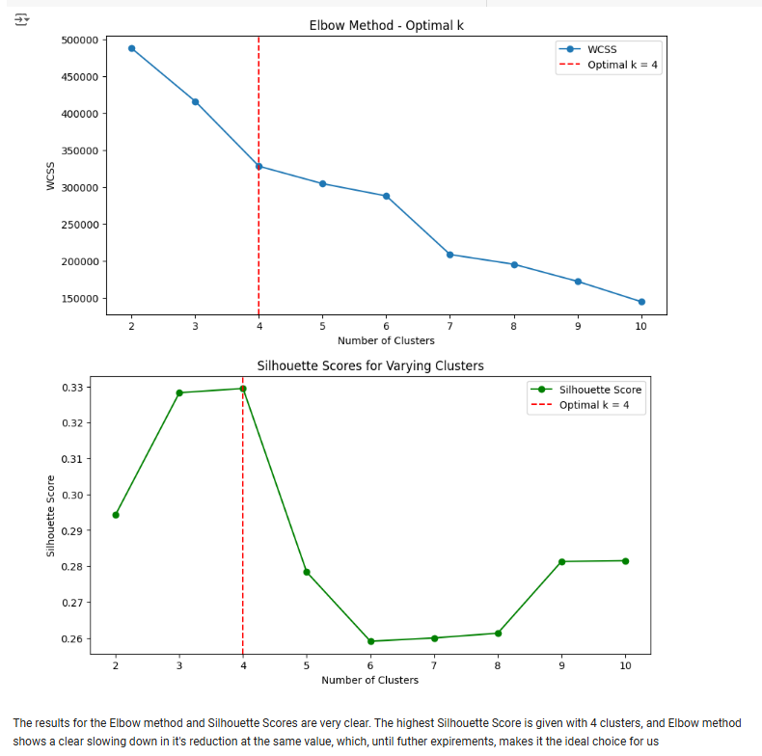
Clustering Analysis

Slide 10
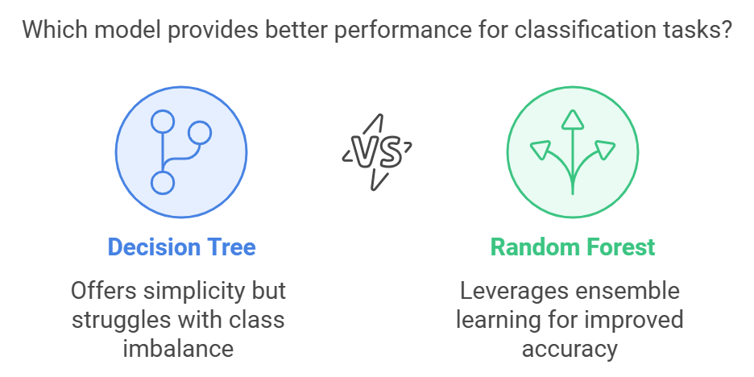
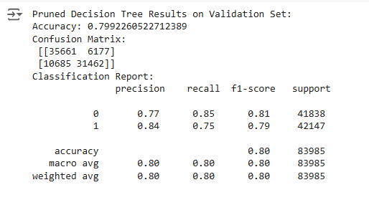
Basic Classifiers (Decision Tree, Random Forest)
- Decision Tree: Initial model struggled with class imbalance.
- SMOTE improved minority class detection.
- Random Forest emerged as robust with high accuracy.
- Key features: Monthly Income, Debt Ratio.

Slide 11
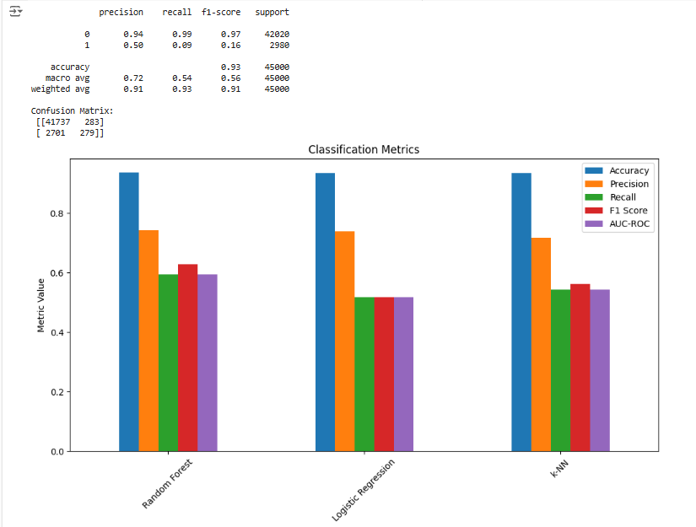
RANDOM FOREST

Slide 12
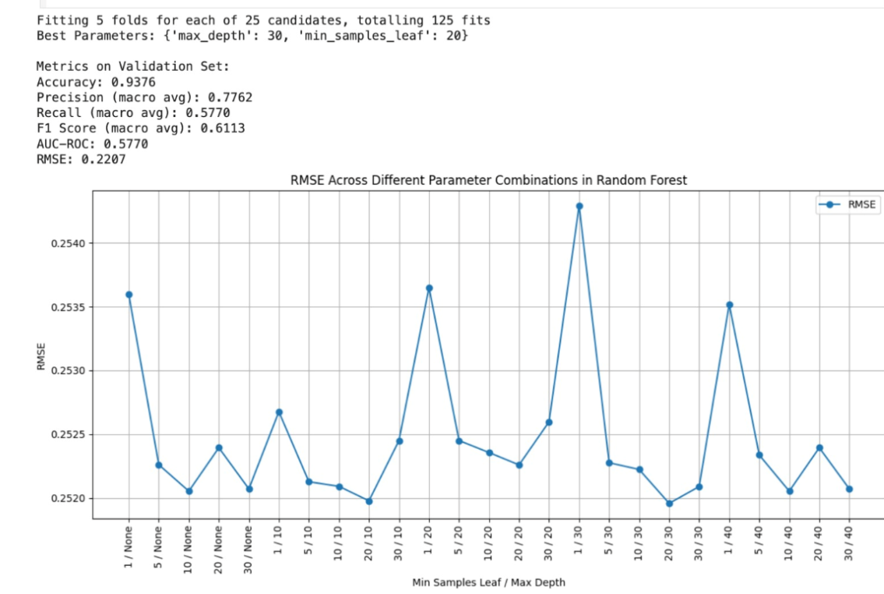
RANDOM FOREST

Slide 13
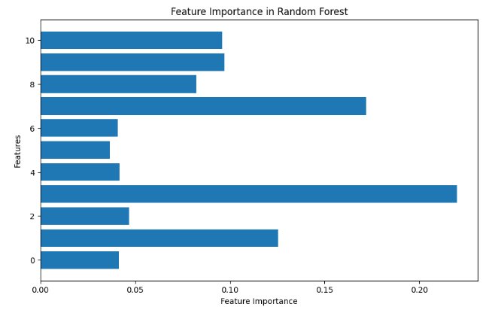
RANDOM FOREST

Slide 14

Neural Networks (MLP & CNN)
MLP:
- Explored feasibility for hand sign classification.
CNN:
- Outperformed MLP with high accuracy.
- Techniques: Data augmentation, ReLU activation.
- Robust against overfitting.

Slide 15
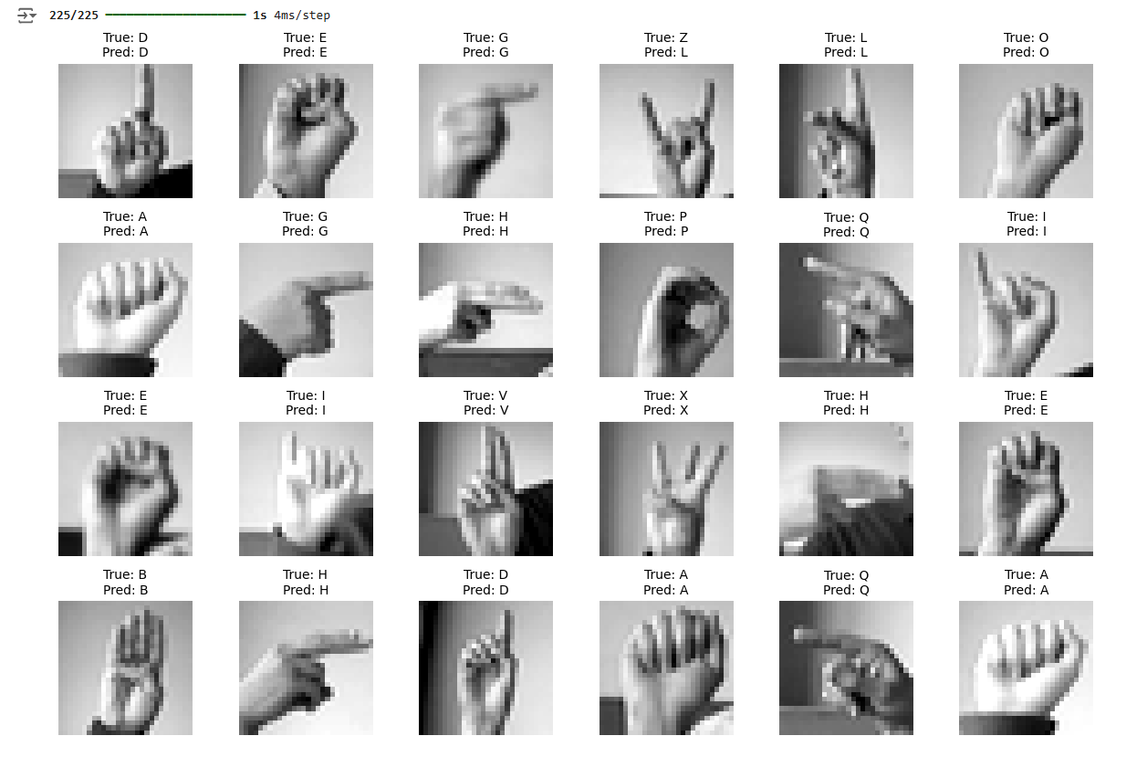
MLP

Slide 16
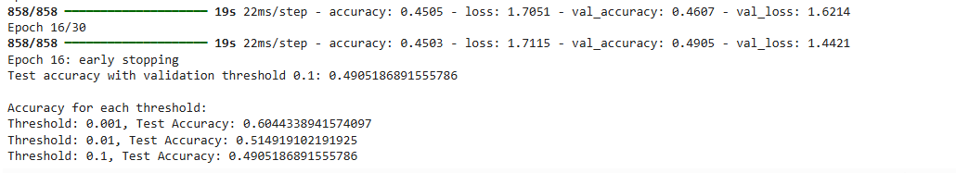
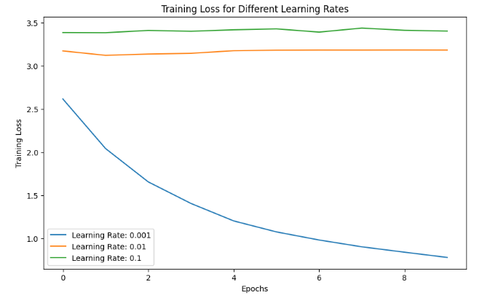
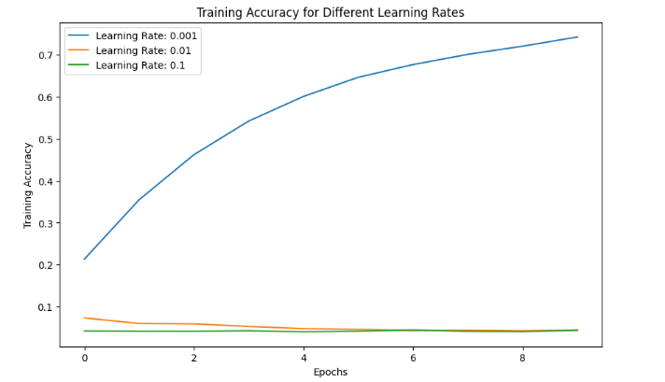
MLP

Slide 17
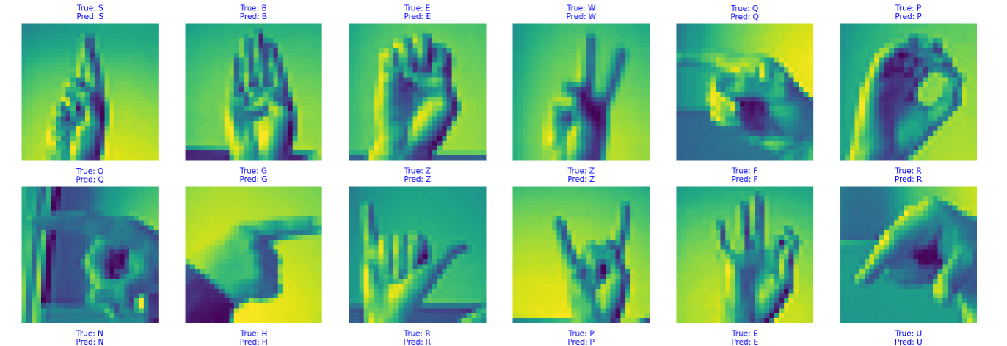
CNN

Slide 18
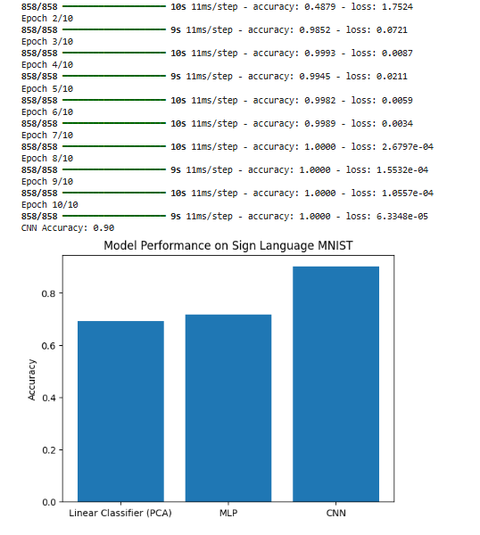
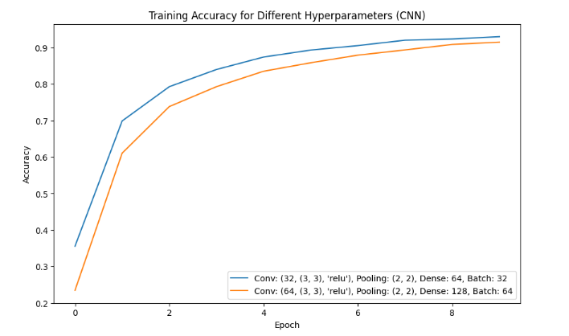
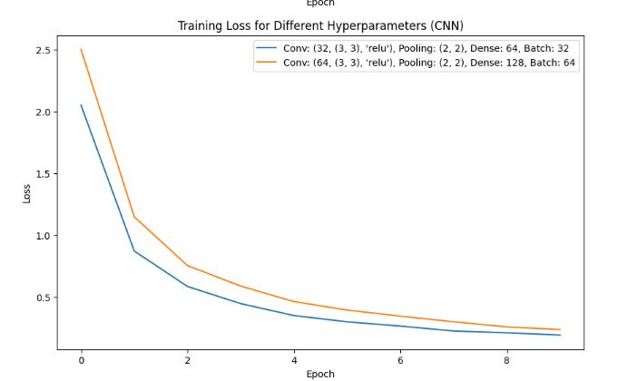
CNN

Slide 19
Conclusion
Dataset 1:
How does monthly income affect financial distress?
Analysis revealed that Monthly Income is a key determinant of financial distress, with individuals earning lower incomes being more likely to experience delinquency. Techniques such as median imputation preserved the integrity of this feature despite missing values. Furthermore, feature importance analysis in Random Forest and XGBoost confirmed Monthly Income as one of the top predictors of financial risk.
Can clustering techniques such as K-Means be applied to segment individuals?
Clustering with K-Means proved effective in segmenting individuals based on their financial attributes. Using the Elbow Method and Silhouette Scores, we identified four optimal clusters representing distinct financial profiles, such as low-income, high-debt individuals and high-income, low-debt customers.

Slide 20
Conclusion
Dataset 2:
How can sign language recognition models generalize across different individuals with varying hand shapes, speeds, and styles?
Generalization was achieved by employing data augmentation techniques, such as rotations, flips, and zooms, to simulate real-world variations in hand gestures. Convolutional Neural Networks (CNNs) demonstrated superior performance in recognizing diverse hand shapes and styles, achieving high accuracy with minimal overfitting. This approach ensures robustness across different user profiles, paving the way for broader adoption.
Can a unified machine learning model be trained to recognize signs from multiple sign languages and differentiate between them?
While this dataset focused on American Sign Language (ASL), the results suggest that CNNs, combined with transfer learning from pre-trained models, could be extended to recognize signs from multiple languages

Slide 21
Best Solution
For Dataset 1 (Financial Distress Prediction):
The Random Forest and XGBoost models, optimized with SMOTE to address class imbalance, emerged as the best classifiers. These models achieved high accuracy, precision, and AUC-ROC scores, effectively predicting delinquency while handling imbalanced datasets. Feature importance analysis provided actionable insights, identifying NumberOfTimes90DaysLate and DebtRatio as other key predictors alongside Monthly Income.
For Dataset 2 (Sign Language Recognition):
The CNN architecture, with data augmentation and ReLU activation, delivered the best results for sign language classification. This model achieved high accuracy on both training and test sets while maintaining robustness against overfitting.

Slide 22
WEEKLY PROGRESS
WEEK 1 & 2
Formed as a group
WEEK 3 & 4
Data set selection and presentation. MNIST dataset for CNN analysis was chosen
WEEK 5
Add. Data set for supervised learning added and presented. So we have 2 data set.
WEEK 6
R2 - EDA Analysis
WEEK 7
R3 – Clustering, K-means clustering, Elbow Method and Silhouette Score
WEEK 8
R4 – Decision Tree, Random Forest, XGboost
WEEK 9
R5- MLP & CNN for MNIST Dataset
WEEK 10 & 11
Code checking, report presentation and submission
Alternative Dataset Analysis

